Slide 1
Computer Vision & Pattern Recognition
Topic: GAN for Object Detection
Paper Name: Analyzing and Improving the Image Quality of StyleGAN

Slide 2
Group Members
Name | Id
Md. Samiul Hauque Chowdhury | 18-36072-1
Md. Sabbir Hasan | 17-33918-1
Mehedi Hasan Joy | 18-38413-2
Shihab Hossain | 18-38131-2
Fahad, Abdullah Al | 18-37904-2

Slide 3
Introduction:
What is GAN?
GAN is an unsupervised learning task that involves automatically discovering and learning the patterns in input data in such a way that the model can be used to generate or opt new examples that plausibly could have been draw from the original dataset.
What is StyleGAN?
StyleGAN proposes large changes to the generator model including the use of a mapping network to map points in latent space to an intermediate latent space.

Slide 4
Introduction:
What do the authors focus on?
Identifying two causes for these artifacts.
Proposing alternate design.
Final output of this paper.

Slide 5
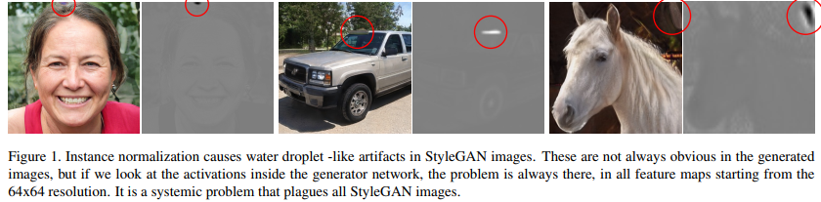
Removing Normalization Artifacts
Most images generated by StyleGAN exhibit characteristic blob-shaped artifacts that resemble water droplets. The anomaly starts to appear around 64×64 resolution, is present in all feature maps, and becomes progressively stronger at higher resolutions. So, we need to follow the below steps to remove the artifacts:

Slide 6
2.1 Generator architecture revisited
Revise several details of the StyleGAN generator
Breaking the AdaIN operation to its two constituent parts: normalization and modulation.
Re-draw the conceptual gray boxes so that each box indicates the part of the network where one style is active.
Move these operations outside the style block, where they operate on normalized data to get more predictable data.
The application of bias, noise, and normalization to the constant input can also be safely removed without observable drawbacks.

Slide 7
2.2 Instance normalization revisited
We will now propose a better alternative that removes the artifacts while retaining full controllability. The main idea is to base normalization on the expected statistics of the incoming feature maps, but without explicit forcing.
Style modulation may amplify certain feature maps by an order of magnitude or more.
Counteract this amplification on a per-sample basis
The modulation scales each input feature map of the convolution based on the incoming style
The purpose of instance normalization is to essentially remove the effect of the scale corresponding to the ith input from the statistics of the convolution’s output feature maps.
Previous demodulation technique is weaker because it is based on statistical assumptions about the signal instead of actual contents of the feature maps.

Slide 8
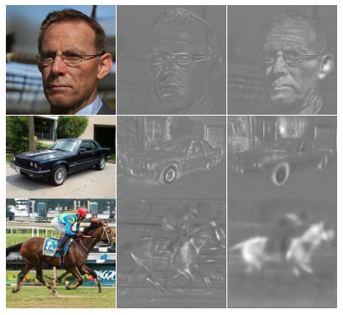
2.2 Instance Normalization Revisited(contd.)
Our demodulation is also related to weight normalization that performs the same calculation as a part of reparametrizing the weight tensor.
New design removes the characteristic artifacts while retaining full controllability

Slide 9
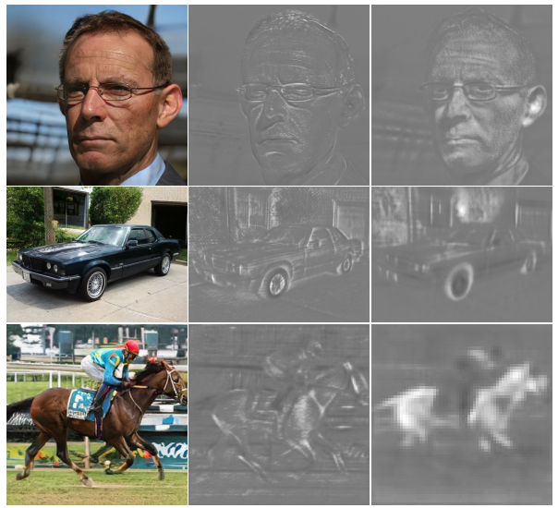
Part-3 Abdullah Al Fahad Image Quality & Generator smoothness
After Applying GAN Matrics it leaves some what of blind spots in image Quality
* We discovered that classifiers trained using ImageNet tend to base their decisions much more on texture than shape

Slide 10

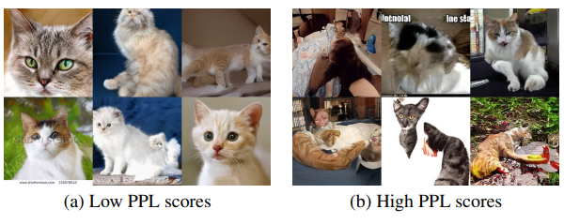
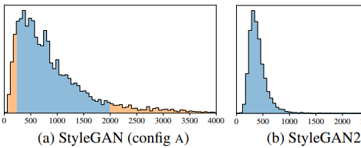
Random examples with low PPL (≤ 10th percentile). & with high PPL (≥ 90th percentile)
PPL (smoother generator mapping) appears to correlate with higher overall image quality
It is not immediately obvious why a low PPL should correlate with image quality. We hypothesize that during training, as the discriminator penalizes broken images, the most direct way for the generator to improve is to effectively stretch the region of latent space that yields good images.

Slide 11
Solution:
A new image regularizer that aims for a smoother generator mapping without this drawback.
1. Lazy regularization: We observe that the regularization terms can be computed less frequently than the main loss function
2. Path length regularization: we notice that path length regularization leads to more reliable and consistently behaving models, making architecture exploration easier.

Slide 12
4.Progressive growing revisited
by
MD. Shihab Hossain
ID: 18-38131-2

Slide 13
Progressive growing has been very successful in stabilizing high-resolution image synthesis, but it causes its own characteristic artifacts. The key issue is that the progressively grown generator appears to have a strong location preference for details.

Slide 14
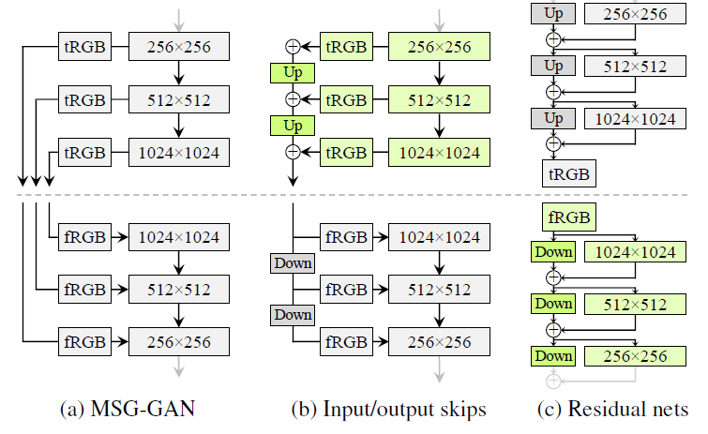
we simplify this design by upsampling and summing the contributions of RGB outputs corresponding to different resolutions. In the discriminator, we similarly provide the downsampled image to each resolution block of the discriminator. We use bilinear filtering in all up and downsampling operations.

Slide 15
Alternative network architectures
While StyleGAN uses simple feedforward designs in the generator (synthesis network) and discriminator, there is a vast body of work dedicated to the study of better network architectures.
For the rest of the paper we use a skip generator and a residual discriminator, without progressive growing.

Slide 16
Resolution usage
The key aspect of progressive growing, which we would like to preserve, is that the generator will initially focus on low-resolution features and then slowly shift its attention to finer details.

Slide 17
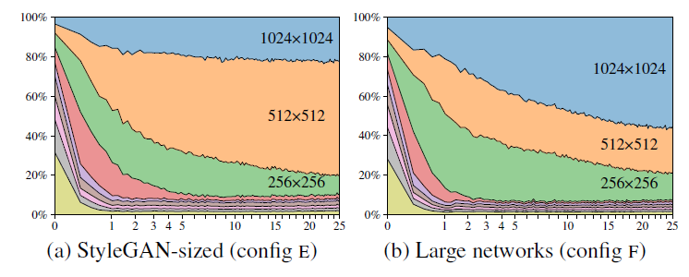
(a)we plot the standard deviation of the pixel values produced by each tRGB layer as a function of training time. We calculate the standard deviations over 1024 random samples of w and normalize the values so that they sum to 100%.
(b)shows a significant increase in the contribution of the highest-resolution layers

Slide 18
Part 5 Projection of images to latent space and Conclusion
By
Mehedi Hasan Joy 18-38413-2

Slide 19
Projection of images to latent space
While extending the latent space in this fashion finds a closer match to a given image, it also enables projecting arbitrary images that should have no latent representation.
Instead, we concentrate on finding latent codes in the original, unextended latent space, as these correspond to images that the generator could have produced.
First, we add ramped-down noise to the latent code during optimization in order to explore the latent space more comprehensively. Second, we also optimize the stochastic noise inputs of the StyleGAN generator, regularizing them to ensure they do not end up carrying coherent signal

Slide 20
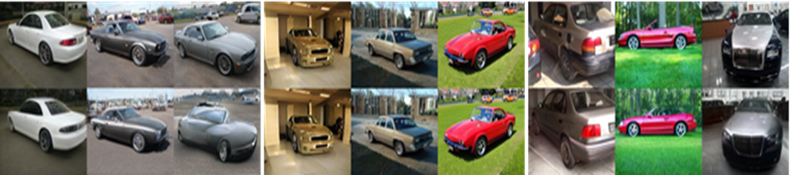
With the baseline StyleGAN, projection often finds a reasonably close match for generated images, but especially the backgrounds differ from the originals. The images generated using StyleGAN2 can be projected almost perfectly back into generator inputs, while projected real images (from the training set) show clear differences to the originals, as expected. All tests were done using the same projection method and hyper parameters

Slide 21
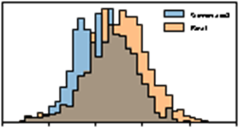
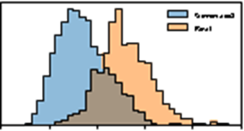
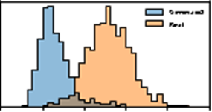
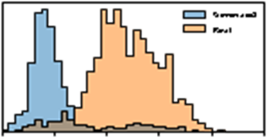
LPIPS distance histograms between original and pro- jected images for generated (blue) and real images (orange). De- spite the higher image quality of our improved generator, it is much easier to project the generated images into its latent space W. The same projection method was used in all cases. We measure how well the projection succeeds by computing the LPIPS distance between original and resynthesized image
LSUN CAR, StyleGAN
FFHQ, StyleGAN
LSUN CAR, StyleGAN2
FFHQ, StyleGAN2

Slide 22
Conclusions
We have identiﬁed and ﬁxed several image quality is- sues in StyleGAN, improving the quality further and considerably advancing the state of the art in several datasets. Despite the improved quality, StyleGAN2 makes it easier to attribute a generated image to its source
Training performance has also improved. At 10242 resolution, the original StyleGAN (config A in Table 1) trains at 37 images per second on NVIDIA DGX-1 with 8 Tesla V100 GPUs, while our config E trains 40% faster at 61 img/s.

